Slide 1
The American Education System:
How does Early Education influence us?
By. Agapeh Zadooryin Perani

Slide 2
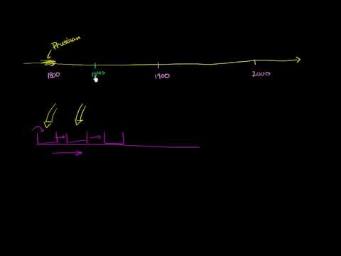
The History of Education

Slide 3
Formal vs Informal Education
Formal Education takes place in a classroom with educated teachers and sometimes teachers assistants.
Informal Education takes place outside of a traditional classroom setting. (at home, at a museum, at a camp)

Slide 4
Major Participants
Teachers are the ones who hold the key to form student’s perspective on education. They teach students things they have never heard of and try to make it as fun as possible so students don’t have a hard time learning.
Principal/Administration can also influence a student’s attitude toward education. They have the power to allow exciting activities to occur at school.
Students try to keep up with everything they are being taught
Parents usually encourage and help their kids to learn

Slide 5
“How Education Affects Early Child Development”
“How Education Affects Early Child Development” by Karen LoBello is an article on a parenting website that offers a lot of insight on how education bulls confidence. It talks about how education increases social development, physical development, cognitive skills and more.
"When education and early childhood are paired together, parents often come down on one side or the other -- the only acceptable option is at home with mom, or the only acceptable option is immediate introduction to a formal setting that promotes social and cognitive development. I really don't think it needs to be such a dichotomy, though," says Dr. Katherine Glenn-Applegate, associate professor of education at Ohio Wesleyan University. The simple truth is kids thrive when they are in enriching, stimulating environments with supportive, caring others, and that can happen at home, at a preschool or running errands with grandpa.

Slide 6
How people view Early education
Early Education by definition is a branch of education theory which relates to the teaching of young children (formally and informally) up until the age of about eight. Infant/toddler education, a subset of early childhood education, denotes the education of children from birth to age two.
Is it accessible to everyone? In America, education is very accessible compared to other countries. The quality of the education may vary due to location. Early education specifically is not always as accessible due to budgeting in some areas. Early childhood education is not mandated by the United States Department of Education. Elementary and secondary education is all that is legally required for students, though early childhood education is doubtlessly an important and fundamental stage of learning.

Slide 7
An Early Education
The article “An Early Education: New Jersey's CIO got a taste of business at a
young age, which he says prepared him well for managing pension assets for the
state” by Timothy Walsh tells the story of a CIO who at an early age learned
about finance. He was taught how to really the Wall Street Journal at a young age
and in the article Walsh talks about how his early education influenced him in his
adult years.

Slide 8
How do teachers view Early Education?
The Huffington Post published an article that featured benefits of an early education according to real teachers.
Socialization
Cooperation
Encouraging holistic cooperation
Enthusiasm for lifelong learning
Convey the value of education through experience
Confidence and self esteem
Exposure to diversity

Slide 9
“Early Education” by Henry Petroski
“Early Education” by Henry Petroski talks about how early education influences people even in their teen and adult years. There is a part of the article that mentions how teens are not exposed to engineering and therefore college students don't really know what the major is all about. It also talks about how shoes are the first machines we are given as kids and how we must master to tie our shoes before we do anything else.

Slide 10
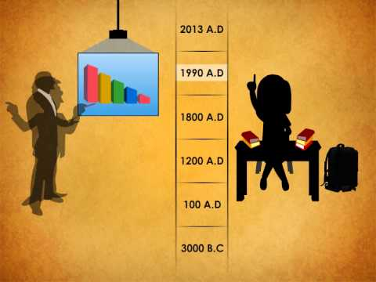
How Has education changed over time?
What stayed the same?

Slide 11
Functionalist Analysis
Functionalism - society is a system of interconnected parts that work together in harmony to maintain a state of balance and social equilibrium for the whole
Education - offers a way to transmit a society’s skills, knowledge, and culture to its youth

Slide 12
Conflict Analysis
Conflict Perspective- views society as composed of different groups and interest competing for power and resources.
People living in poor areas are not likely to get formal early education because early education is not mandatory. On the other hand those living lavish lives in Brentwood might not mind spending money for their kids to get early education as it may also give the parents some more free time. Although the kids in the less fortunate communities may not be getting formal early education, they may learn a lot from the things going around them.

Slide 13
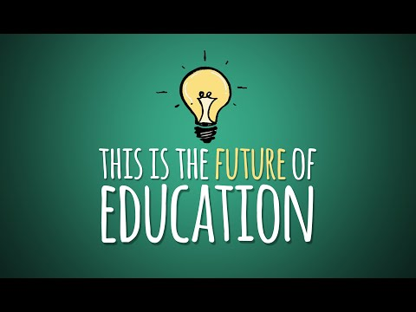
Future of Education?

Slide 14
Works Cited
"Early Childhood Education." Teach.com. TEACH, n.d. Web. 23 July 2016.
LoBello, Karen. "How Education Affects Early Child Development." (2013): n. pag. Web. 15 July 2016.
OurSocialVoice. "This Is the Future of Education." YouTube. John Spencer, 17 Feb. 2016. Web. 22 July 2016.
Palmer, Vicki. "The 13 Key Benefits of Early Childhood Education: A Teacher's Perspective." The Huffington Post. TheHuffingtonPost.com, 06 Aug. 2016. Web. 22 July 2016.
Petrosky, Henry. "Early Education." American Scientist 91.3 (2003): n. pag. Web. 15 July 2016.
Qpagep. "How Education Has Changed in past Years?? Teaching and Learning at Qpage Www.qpagep.com." YouTube. YouTube, 06 June 2013. Web. 22 July 2016.
Walsh, Timothy M. "An Early Education." Pensions & Investments (2011): n. pag. Pionline. Web. 15 July 2016.

